Slide 1
Deploy with Confidence!
Making your micro-services pay nicely together with Pact and Consumer Driven Contracts
Ronald Holshausen
rholshausen@dius.com.au
@RHolshausen

Slide 2
Picture the scene

Slide 3
Monday Morning

Slide 4
9AM

Slide 5
You just got in to work

Slide 6
You haven’t had a coffee

Slide 7
You get pulled into a meeting

Slide 8
The weekends security roll-out failed

Slide 9
It broke everything in production

Slide 10
Due to a API change

Slide 11
Which you did not implement

Slide 12
And when you ask about it

Slide 13
Didn’t you read the yammer post?

Slide 14
This is a real story

Slide 15
Kind of

Slide 16
`What we got here is a failure to communicate`
Notes:
Most people in IT are terrible at communicating
Systems are becoming more distributed
This strains communications
Telstra took 2 days to to fix an API call in a UAT environment

Slide 17
Everyone's moving to micro-services
Notes:
This is only going to get worse
we are writing more of them and testing is only going to get harder
Our current tooling and thinking is old and not suitable for this problem.

Slide 18
Notes:
This is only going to get worse
we are writing more of them and testing is only going to get harder
Our current tooling is old and not suitable for this problem.

Slide 19
Notes:
This is only going to get worse
we are writing more of them and testing is only going to get harder
Our current tooling is old and not suitable for this problem.

Slide 20
Notes:
This is only going to get worse
we are writing more of them and testing is only going to get harder
Our current tooling is old and not suitable for this problem.

Slide 21
How do you test this?
Notes:
We required the same skills to diagnose production and integration test defects
Often they have false negatives
The are “All knowing”
Path complexity is exponential
To keep end to end tests fast and reliable, we reduce the scope of testing to just smoke level

Slide 22
Notes:
We required the same skills to diagnose production and integration test defects
Often they have false negatives
The are “All knowing”
Path complexity is exponential
To keep end to end tests fast and reliable, we reduce the scope of testing to just smoke level

Slide 23
`Integration tests are a scam`
J.B. Rainsberger

Slide 24
Notes:
We’ve shown that communication failure leads to system issues.
Integration testing helps give us confidence that all parts of the system are working together.

Slide 25
Notes:
We’ve shown that communication failure leads to system issues.
Integration testing helps give us confidence that all parts of the system are working together.

Slide 26
Notes:
We’ve shown that communication failure leads to system issues.
Integration testing helps give us confidence that all parts of the system are working together.

Slide 27
Consumer Driven Contracts
Notes:
Ian Robinson
Strategy for evolving a service

Slide 28
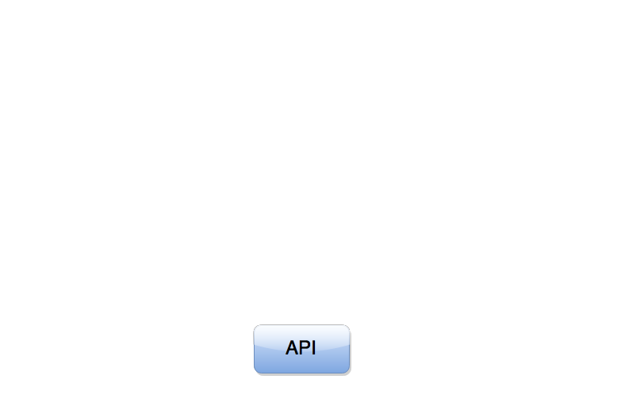
Notes:
Most people in IT are terrible at communicating
Systems are moving further apart, becoming more distributed
This strains communications
Jetstar suffered a recent serious failure whose blame lay solely at internal communications.

Slide 29
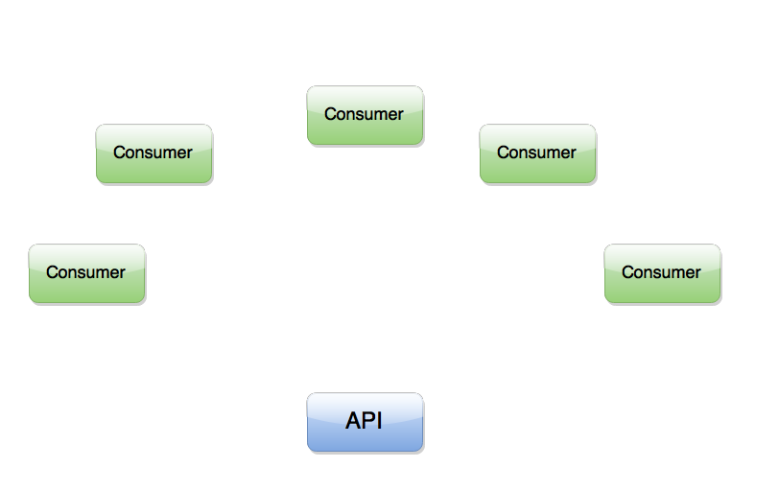
Notes:
Most people in IT are terrible at communicating
Systems are moving further apart, becoming more distributed
This strains communications
Jetstar suffered a recent serious failure whose blame lay solely at internal communications.

Slide 30

Notes:
Most people in IT are terrible at communicating
Systems are moving further apart, becoming more distributed
This strains communications
Jetstar suffered a recent serious failure whose blame lay solely at internal communications.

Slide 31
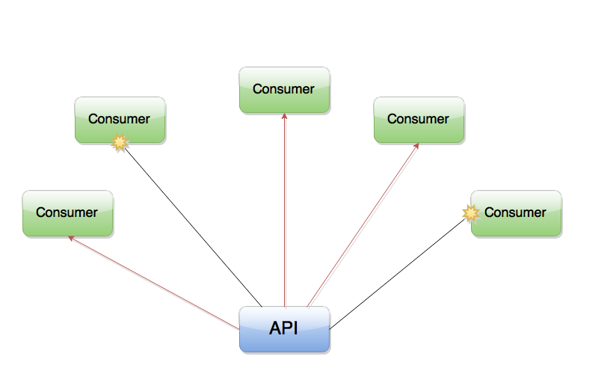
Notes:
Most people in IT are terrible at communicating
Systems are moving further apart, becoming more distributed
This strains communications
Jetstar suffered a recent serious failure whose blame lay solely at internal communications.

Slide 32
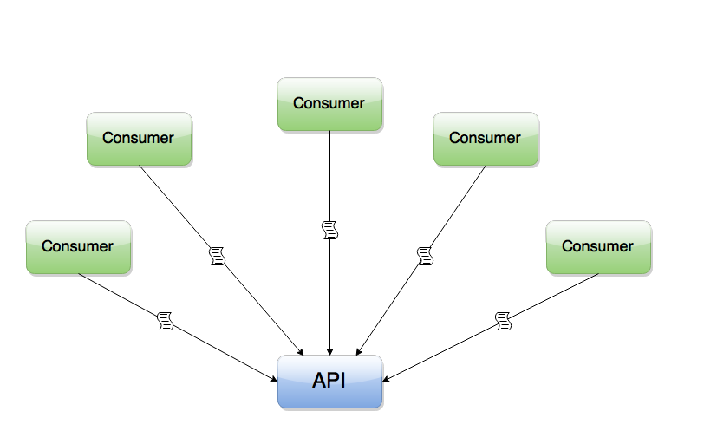
Notes:
Most people in IT are terrible at communicating
Systems are moving further apart, becoming more distributed
This strains communications
Jetstar suffered a recent serious failure whose blame lay solely at internal communications.

Slide 33
Benefits?

Slide 34
You’ll know when you break a consumer

Slide 35
You have a form of documentation

Slide 36
Pact
www.pact.io
Notes:
Pact evolved out of these two principles

Slide 37
Evolved from combining these two principals
Notes:
Pact evolved out of these two principles

Slide 38
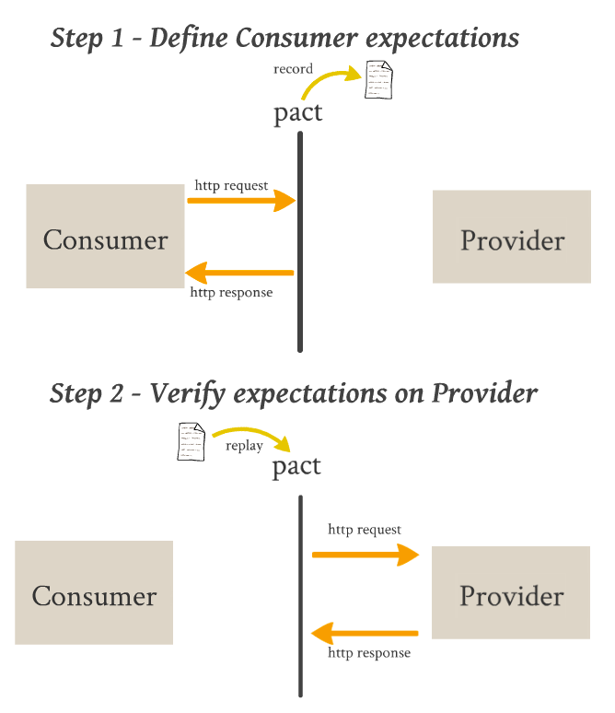
Notes:
This is how it works
1) firstly establish a pact/agreement between the service consumer and the service provider as a consumer test
This results in a pact file
2) Secondly, let Pact verify that the provider honours the pact with the consumer

Slide 39

Notes:
All about your risk profile
Integration tests have a high cost and low benefit
Challenging the safety net thinking

Slide 41
So how does it work?

Slide 42
Notes:
This is how it works
1) firstly establish a pact/agreement between the service consumer and the service provider as a consumer test
This results in a pact file
2) Secondly, let Pact verify that the provider honours the pact with the consumer

Slide 43
Start with a consumer test

Slide 44
Given “some state exists”
When I Receive “a GET request for data”
With “these headers and query”
Respond with “200 OK”
And “this data in the body”
Notes:
You test validates your HTTP client code against your expectations

Slide 45
Given “User A exists”
When I Receive “a GET request for user A”
Respond with “200 OK”
And “User A’s details in the body”
Notes:
You test validates your HTTP client code against your expectations

Slide 46
Given “User A does not exist”
When I Receive “a GET request for user A”
Respond with “404 Not Found”
Notes:
You test validates your HTTP client code against your expectations

Slide 47
Ruby
JVM (Java, Groovy, Scala, Clojure)
.Net (1.1)
JavaScript/Node.js (Mocha, Jasmine)
Rust/Go/Python/PHP

Slide 48
Java Example

Slide 49
@Rule
public PactProviderRule provider = new PactProviderRule("test_provider", "localhost", 8080, this);
@Pact(provider="test_provider", consumer="test_consumer")
public PactFragment createFragment(PactDslWithProvider builder) {
Map<String, String> headers = new HashMap<String, String>();
headers.put("testreqheader", "testreqheadervalue");
return builder
.given("test state")
.uponReceiving("ExampleJavaConsumerPactRuleTest test interaction")
.path("/")
.method("GET")
.headers(headers)
.willRespondWith()
.status(200)
.headers(headers)
.body("{\"responsetest\": true, \"name\": \"harry\"}")
.given("test state")
.uponReceiving("ExampleJavaConsumerPactRuleTest second test interaction")
.method("OPTIONS")
.headers(headers)
.path("/second")
.body("")
.willRespondWith()
.status(200)
.headers(headers)
.body("")
.toFragment();
}
@Test
@PactVerification("test_provider")
public void runTest() throws IOException {
Assert.assertEquals(new ConsumerClient("http://localhost:8080").options("/second"), 200);
Map expectedResponse = new HashMap();
expectedResponse.put("responsetest", true);
expectedResponse.put("name", "harry");
assertEquals(new ConsumerClient("http://localhost:8080").getAsMap("/", ""), expectedResponse);
}
Notes:
You test validates your HTTP client code against your expectations

Slide 50
@Rule
public PactProviderRule provider = new PactProviderRule("test_provider", "localhost", 8080, this);
@Pact(provider="test_provider", consumer="test_consumer")
public PactFragment createFragment(PactDslWithProvider builder) {
Map<String, String> headers = new HashMap<String, String>();
headers.put("testreqheader", "testreqheadervalue");
return builder
.given("test state")
.uponReceiving("ExampleJavaConsumerPactRuleTest test interaction")
.path("/")
.method("GET")
.headers(headers)
.willRespondWith()
.status(200)
.headers(headers)
.body("{\"responsetest\": true, \"name\": \"harry\"}")
.given("test state")
.uponReceiving("ExampleJavaConsumerPactRuleTest second test interaction")
.method("OPTIONS")
.headers(headers)
.path("/second")
.body("")
.willRespondWith()
.status(200)
.headers(headers)
.body("")
.toFragment();
}
@Test
@PactVerification("test_provider")
public void runTest() throws IOException {
Assert.assertEquals(new ConsumerClient("http://localhost:8080").options("/second"), 200);
Map expectedResponse = new HashMap();
expectedResponse.put("responsetest", true);
expectedResponse.put("name", "harry");
assertEquals(new ConsumerClient("http://localhost:8080").getAsMap("/", ""), expectedResponse);
}
Notes:
You test validates your HTTP client code against your expectations

Slide 51
@Rule
public PactProviderRule provider = new PactProviderRule("test_provider", "localhost", 8080, this);
@Pact(provider="test_provider", consumer="test_consumer")
public PactFragment createFragment(PactDslWithProvider builder) {
Map<String, String> headers = new HashMap<String, String>();
headers.put("testreqheader", "testreqheadervalue");
return builder
.given("test state")
.uponReceiving("ExampleJavaConsumerPactRuleTest test interaction")
.path("/")
.method("GET")
.headers(headers)
.willRespondWith()
.status(200)
.headers(headers)
.body("{\"responsetest\": true, \"name\": \"harry\"}")
.given("test state")
.uponReceiving("ExampleJavaConsumerPactRuleTest second test interaction")
.method("OPTIONS")
.headers(headers)
.path("/second")
.body("")
.willRespondWith()
.status(200)
.headers(headers)
.body("")
.toFragment();
}
@Test
@PactVerification("test_provider")
public void runTest() throws IOException {
Assert.assertEquals(new ConsumerClient("http://localhost:8080").options("/second"), 200);
Map expectedResponse = new HashMap();
expectedResponse.put("responsetest", true);
expectedResponse.put("name", "harry");
assertEquals(new ConsumerClient("http://localhost:8080").getAsMap("/", ""), expectedResponse);
}
Notes:
You test validates your HTTP client code against your expectations

Slide 52
@Rule
public PactProviderRule provider = new PactProviderRule("test_provider", "localhost", 8080, this);
@Pact(provider="test_provider", consumer="test_consumer")
public PactFragment createFragment(PactDslWithProvider builder) {
Map<String, String> headers = new HashMap<String, String>();
headers.put("testreqheader", "testreqheadervalue");
return builder
.given("test state")
.uponReceiving("ExampleJavaConsumerPactRuleTest test interaction")
.path("/")
.method("GET")
.headers(headers)
.willRespondWith()
.status(200)
.headers(headers)
.body("{\"responsetest\": true, \"name\": \"harry\"}")
.given("test state")
.uponReceiving("ExampleJavaConsumerPactRuleTest second test interaction")
.method("OPTIONS")
.headers(headers)
.path("/second")
.body("")
.willRespondWith()
.status(200)
.headers(headers)
.body("")
.toFragment();
}
@Test
@PactVerification("test_provider")
public void runTest() throws IOException {
Assert.assertEquals(new ConsumerClient("http://localhost:8080").options("/second"), 200);
Map expectedResponse = new HashMap();
expectedResponse.put("responsetest", true);
expectedResponse.put("name", "harry");
assertEquals(new ConsumerClient("http://localhost:8080").getAsMap("/", ""), expectedResponse);
}
Notes:
You test validates your HTTP client code against your expectations

Slide 53
Groovy Example

Slide 54
def 'example V3 spec test'() {
given:
def matcherService = new PactBuilder()
matcherService {
serviceConsumer 'MatcherConsumer'
hasPactWith 'MatcherService'
port 1234
}
matcherService {
uponReceiving('a request')
withAttributes(method: 'put', path: '/')
withBody(mimeType: JSON.toString()) {
name(~/\w+/, 'harry')
surname regexp(~/\w+/, 'larry')
position regexp(~/staff|contractor/, 'staff')
id identifier('1234567890')
age(100)
role {
name('admin')
id(uuid)
kind {
id(100)
}
dob date('MM/dd/yyyy')
}
}
willRespondWith(status: 200)
withBody(mimeType: JSON.toString()) {
name(~/\w+/, 'harry')
}
}
assert response.data == [name: 'harry']
}
then:
result == PactVerified$.MODULE$
}
Notes:
You test validates your HTTP client code against your expectations

Slide 55
when:
VerificationResult result = matcherService.run(specificationVersion: PactSpecVersion.V3) {
def client = new RESTClient('http://localhost:1234/')
def response = client.put(requestContentType: JSON, body: [
'name': 'harry',
'surname': 'larry',
'position': 'staff',
'id': 6444667731,
'age': 32,
'role': [
'name': 'admin',
'id': '7a97e929-c5b1-43cf-9b2c-295e9d4fa3cd',
'kind': [
'id': 100
],
'dob': '12/05/2015'
]
]
)
assert response.status == 200
assert response.data == [name: 'harry']
}
then:
result == PactVerified$.MODULE$
}
Notes:
You test validates your HTTP client code against your expectations

Slide 56
Next publish your pacts

Slide 57
{
"provider": {
"name": "Alice Service"
},
"consumer": {
"name": "Consumer"
},
"interactions": [
{
"providerState": "",
"description": "a retrieve Mallory request",
"request": {
"method": "GET",
"path": "/mallory",
"query": "name=ron&status=good",
"body": null
},
"response": {
"status": 200,
"headers": {
"Content-Type": "text/html"
},
"body": "\"That is some good Mallory.\""
}
}
],
"metadata": {
"pact-specification": {
"version": "2.0.0"
},
"pact-jvm": {
"version": "3.2.7"
}
}
}
Notes:
You test validates your HTTP client code against your expectations

Slide 58
PactBroker
Build Artifacts
S3
Version Control

Slide 59
Then verify your provider

Slide 60
Gradle
Maven
Leiningen
SBT
JUnit
Ruby (Rake)
.Net (xUnit)
JS (NPM, Grunt, …)
Go

Slide 61
Verifying a pact between sampleconsumer and Activity Service
[Using file /home/ronald/Development/Projects/Pact/pact-gradle-test/src/test/resources/sample-pact.json]
Given many activities exist
WARNING: State Change ignored as there is no stateChange URL
a request for activities
returns a response which
has status code 200 (OK)
includes headers
"Content-Type" with value "application/json" (OK)
has a matching body (OK)
Verifying a pact between sampleconsumer2 and Activity Service
[Using file /home/ronald/Development/Projects/Pact/pact-gradle-test/src/test/resources/sample-pact2.json]
Given many activities exist
WARNING: State Change ignored as there is no stateChange URL
a request for activities
returns a response which
has status code 200 (OK)
includes headers
"Content-Type" with value "application/json" (OK)
has a matching body (OK)
Verifying a pact between sampleconsumer3 and Activity Service
[Using file /home/ronald/Development/Projects/Pact/pact-gradle-test/src/test/resources/sample-pact3.json]
add a broker
returns a response which
has status code 200 (OK)
includes headers
"Content-Type" with value "text/plain;charset=UTF-8" (OK)
has a matching body (OK)
:pactVerify
BUILD SUCCESSFUL

Slide 62
Verifying a pact between sampleconsumer and Activity Service
[Using file /home/ronald/Development/Projects/Pact/pact-gradle-test/src/test/resources/sample-pact.json]
Given many activities exist
WARNING: State Change ignored as there is no stateChange URL
a request for activities
returns a response which
has status code 200 (OK)
includes headers
"Content-Type" with value "application/json" (OK)
has a matching body (FAILED)
Failures:
0) Verifying a pact between sampleconsumer and Activity Service - a request for activities Given many activities exist returns a
response which has a matching body
$.body.activities -> Expected List(Map(description -> 100, id -> 100, name -> Bob)) to have minimum 2
$.body.activities.0.description -> Expected 100 to be the same type as 'f_UXcxIXYhgqtxjiPumRiCo9C5JNDX'
Diff:
@3
{
- "description": "f_UXcxIXYhgqtxjiPumRiCo9C5JNDX",
- "name": "hx55sbvMPk1kF-9"
- },
- {
- "description": "f_UXcxIXYhgqtxjiPumRiCo9C5JNDX",
- "name": "hx55sbvMPk1kF-9"
+ "description": 100,
+ "id": 100,
+ "name": "Bob"
}
:pactVerify_Activity Service FAILED
FAILURE: Build failed with an exception.
* What went wrong:
There were 1 pact failures for provider Activity Service

Slide 63
Well, that’s interesting ...

Slide 64
Specification by Example

Slide 65
TDD for services

Slide 66
But ...

Slide 67
A pitfall for every person

Slide 68
Isolated build data dependency

Slide 74
True Mock Server
JUnit Provider Test

Slide 75
@RunWith(PactRunner.class) // Say JUnit to run tests with custom Runner
@Provider("Hello Provider") // Set up name of tested provider
//@PactUrl(urls = {"file:///home/ronald/Development/Projects/Pact/pact-gradle-test/src/test/resources/hello_consumer-hello_provider.json"})
@PactFolder("pacts")
public class ContractTrialTest {
@TestTarget // Annotation denotes Target that will be used for tests
public final Target target = new HttpTarget(5050);
@TargetRequestFilter
public void exampleRequestFilter(HttpRequest request) {
request.addHeader("Authorization", "Basic " + base64StringOf("admin", "admin"));
}
private String base64StringOf(String username, String password) {
return Base64.getEncoder().encodeToString((username + ":" + password).getBytes());
}
}
Notes:
You test validates your HTTP client code against your expectations

Slide 76
More Info
Gitbook: docs.pact.io
Github: realestate-com-au/pact and DiUS/pact-jvm
Google users group: https://groups.google.com/forum/#!forum/pact-support
Gitter: Join the chat at https://gitter.im/realestate-com-au/pact and https://gitter.im/DiUS/pact-jvm
Twitter: @pact_up

Slide 77
Given “The presentation is over”
Upon Receiving “A request for an answer”
With “A valid question”
Respond With “A valid answer”

